Slide 1
Mnemonic Learning Strategies
LaQuana Douglas
Houston Baptist University

Slide 2

Description of strategy, including a brief literature review
Mnemonic learning strategies assist in memorizing information which does not change e.g. facts, towns, terms used in subjects.
The use of this strategy has been accepted for a long time due to its effectiveness.
Allan Paivio a psychologist elaborated its effectiveness through three main reasons: dual coding, organization and association
Notes:
Mneumonic learning strategy is effective in helping students memorize information which takes time to grasp.

Slide 3

participants and setting.
Participants 10 students in total: 5 boys and 5 girls
Two groups for each gender,
Five groups a boy and a girl
Five groups four groups with same gender and fifth group with different genders
All student from twelfth grade, with average class performance.
The study took place in a twelfth grade classroom
Three session within three weeks.
Notes:
The setting of the students in different groups will help in identification of the best way to address group discussion. Gender different will equip use with information of which aspect is performance best, the three weeks will allow a span of tie for students to practice the concepts and also test thei effectiveness of the learning technic.

Slide 4
procedures in chronological order. Include implementation of strategy as well as method of assessment.
I described to the students how do develop mental pictures from information. This will assist the to understand whether to create an image alongside words or just use either alone.
For every concept I described, I ensured high level of precision and complexity so that the students will be confused by the bulk of information.
After the fast session the second and third session will be in smaller groups.
The other practice for each session will be presentation of different capital cities of the world and require the students formulate a mnemonic.
The use of Dual Coding, Organization and Association as devices of mnemonic learning will be taught and put to practice using varies examples from which students will be required to develop their own.
The groups with the most examples and with the highest performance of the oral tests will be rewarded.
The final assessment will be done by individual representatives of each group who will present the groups finding and the other partner will answer questions.
Notes:
The start with huge groups will assist collaborative effort to understand the materials.
After the fast session the second and third session will be in smaller groups that will help rise individual confidence and understanding. Where the previous information will be presented in the same manner and each group to develop their own response

Slide 5

Description of assessment results
Large groups limited performs.
Same gender groups performed below average.
Opposite gender groups performed excellently.
Small groups showed ability to grasp information faster and effectively than large groups.
Creativity and resilience was reflected in students from all groups.
Lack of cooperation between same gender groups.
The study proved effective contribution of mnemonic to boost memory, the students were able to recall all session in the final evaluation as if they were all done in the same day.
In the question and answer evaluation all student performed above average.
Notes:
The study revealed that the bigger the group the lower the performance in all the activities rating for the study. However they were ranked highest for the different examples of mnemonics

Slide 6

Assessment Results
The use of mixed gender groups enables students compete among themselves creating a healthy learning environment.
The use of visual and verbal codes as expressed in Dual Coding assist student connect information with ease, therefore, it ensures the advantage of capturing information which is inconsistent.
The organizational aspect of mnemonic learning strategy allows the student have clear remembrance of information and in perfect synchrony
Association creates connections between unrelated subjects
Notes:
Association creates connections between unrelated subjects enabling better comprehension for students. The association helps the learner remember other things easily by just seeing one of the partners.
The future of learning is embedded in the ability to create memorability, either through dual coding, organization or association because the principles have been tested for decades and still remain viable

Slide 7
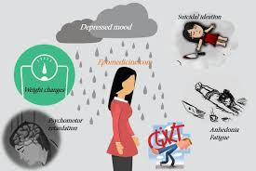

Implications for future use
The future of learning is embedded in the ability to create memorability
Graphic and images with the verbal communication created as a video is what has been developed from this Learning Strategy. A student will listen to the video severally and anytime the graphics appear the video is played in the mind.
Use of technology to create memories using animations and pictures.
Notes:
The ability to remember anything is based on the first encounter, technology has made everything visual, and marking it in our minds through different connotations of creativity using animations and pictures. Mnemonics too are uner the same platform

Slide 8
References
Whitney, M., & Dallas, B. (2019, February). Captioning Online Course Videos: An Investigation into Knowledge Retention and Student Perception. In Proceedings of the 50th ACM Technical Symposium on Computer Science Education (pp. 511-517).
Tureniyazova, A. I. (2019). Using Graphical organizers in the teaching process of ICT. Research in Social Sciences and Technology, 4(2), 31-40.

Slide 9

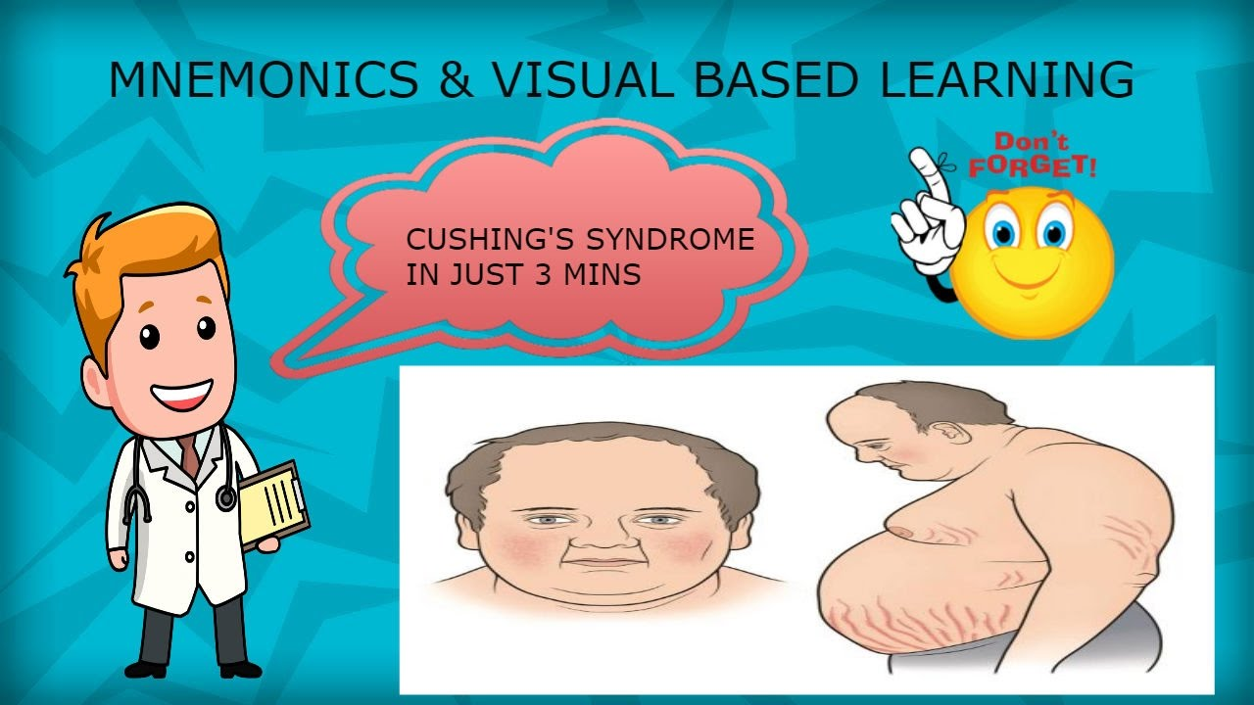


Appendices
Notes:
The main vocabulary for the practice was teamwork for better memory which employed the use of images to explain what team work is about.

